Slide 1

Topics and Subjects
Why pubsub systems look like they do
Clemens Vasters clemensv@microsoft.com @clemensv
© Microsoft Corporation, made available under CC-BY-SA 4.0

Slide 2
Objectives
This slide deck explores the “topic” concept typically found in messaging and eventing infrastructure along several examples.
“Topic” is both a classification/context concept as well as an architectural tool to group event or message streams.
Where a concrete architecture chooses to place a consolidation point along the classification hierarchy of events to groups of messages/events into actual system entities depends on considerations like latency, volume, producer count, law, and others.
Consumers typically register interest for messages at these available consolidation points, which materialize as “topic”, or “exchange”, or “address” in concrete systems
The remaining classification detail is available for filter conditions that allow the consumer to pinpoint the messages/events they want delivered. Detail beyond the chosen classification consolidation point is often broken out as a separate field, such as “subject” or a custom event/message property.
(The examples don’t aim to represent a complete or even completely correct perspective on the respective domain. They’re examples.)

Slide 3
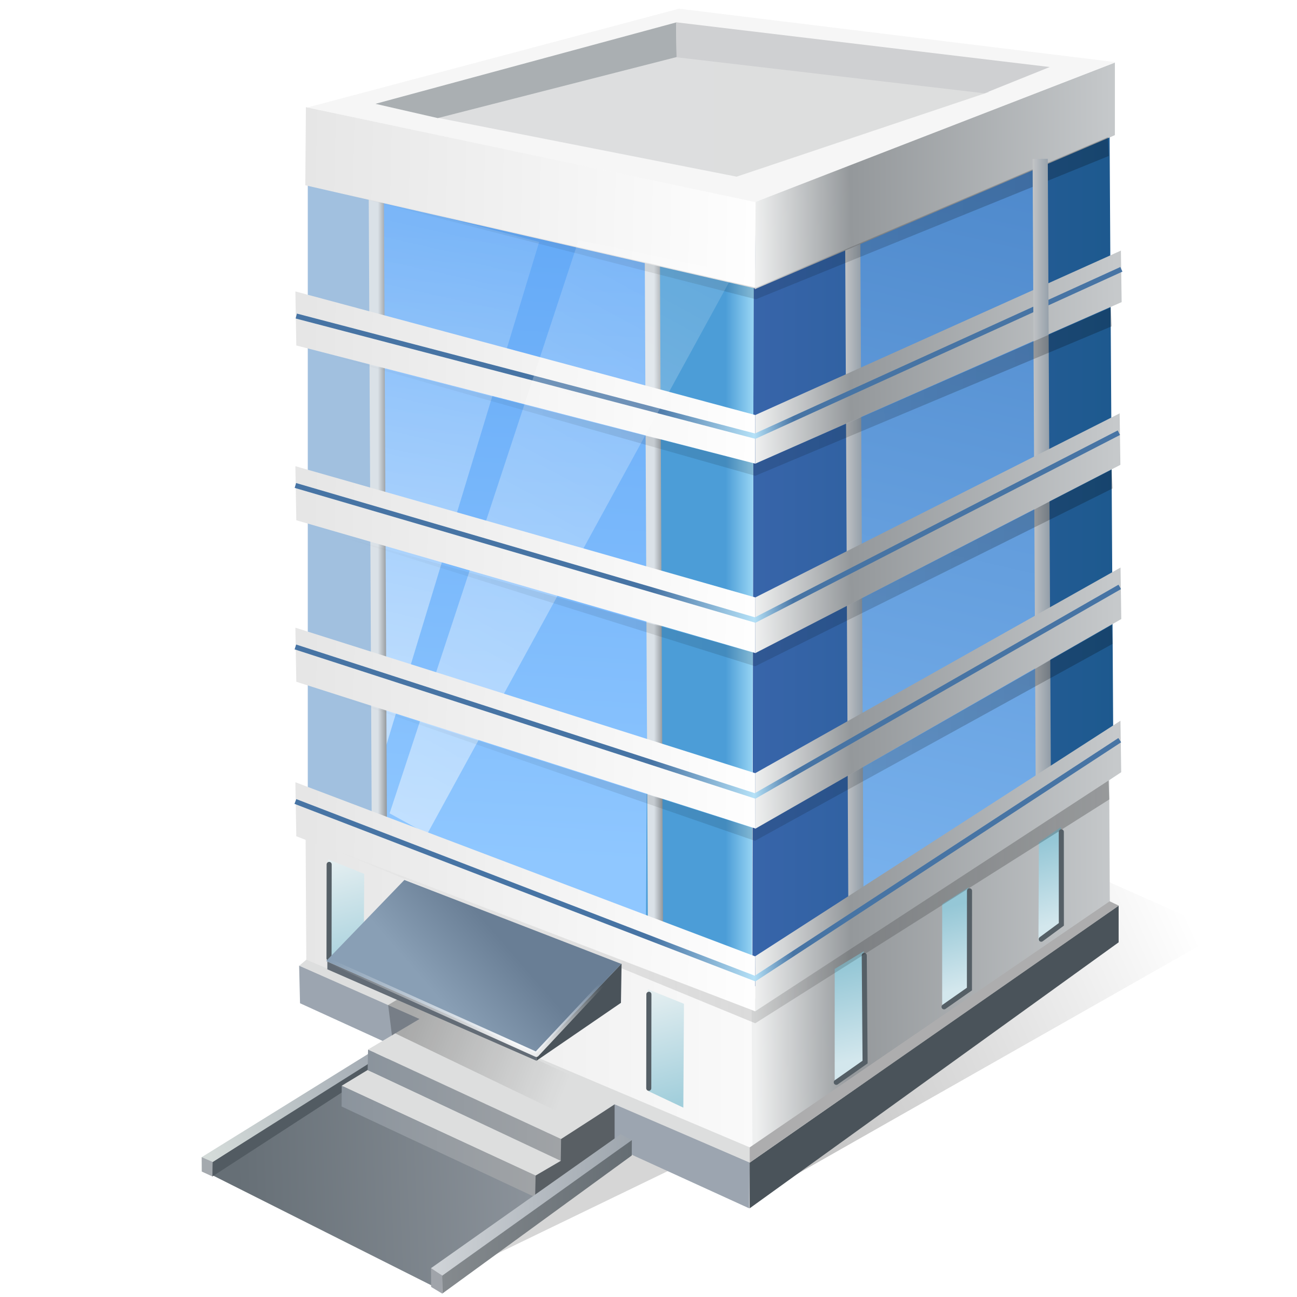
Climate
Energy
Lighting
Water
Gas
Space Utilization
Access Control
Movement Tracking
Elevator/Escalator
Refrigeration
Networking
Fire/Smoke/Gas
Biohazards
Flooding/Wind
Earthquake
Sensors in Buildings: Two Perspectives
…
Building Management
Device Management
Power
Battery
Temperature
Vibration
Component Health
Firmware
TPM
Hypervisor
OS
Container
App
Config
Credentials
Access Control
Traces
Logs
Data
…

Slide 4
/org/contoso/site/berlin/building/41/floor/3/unit/j/room/4/sensors/occupancy
Building Management
/org/contoso/site/berlin/building/41/floor/3/unit/j/room/4/sensors/fire
/org/contoso/site/berlin/building/41/floor/3/unit/j/room/4/sensors/gasbio
/org/contoso/site/berlin/building/41/floor/3/unit/j/room/4/sensors/climate
Org
/org/contoso/
Site
/org/contoso/site/berlin/
Building
/org/contoso/site/berlin/building/41
Floor
/org/contoso/site/berlin/building/41/floor/3
Occupancy
Unit
Fire/Smoke
/org/contoso/site/berlin/building/41/floor/3/unit/j
Gas/Biohaz
Room
Climate
/org/contoso/site/berlin/building/41/floor/3/unit/j/room/4

Slide 5
/org/contoso/site/berlin/building/41/floor/3/unit/j/room/4/sensors/occupancy
Building Management
/org/contoso/site/berlin/building/41/floor/3/unit/j/room/4/sensors/fire
/org/contoso/site/berlin/building/41/floor/3/unit/j/room/4/sensors/gasbio
/org/contoso/site/berlin/building/41/floor/3/unit/j/room/4/sensors/climate
Org
Some Analytics Questions:
Are there people in room 41 3J/4?
What room is unoccupied in building 41?
Is there a fire alarm at the site?
How is the air quality on the lab floor?
What’s the temp in tenant unit 41 3J?
Some Reactive Actions:
Signal evacuation and alert the Fire Department if any fire or gas/biohaz sensor on site goes into an alert state.
Adjust floor HVAC when average temp on any building floor deviates by +/- 2C from 20C.
Alert Security when unexpected occupancy is detected in Unit 41 3J.
/org/contoso/
Site
/org/contoso/site/berlin/
Building
/org/contoso/site/berlin/building/41
Floor
/org/contoso/site/berlin/building/41/floor/3
Occupancy
Unit
Fire/Smoke
/org/contoso/site/berlin/building/41/floor/3/unit/j
Gas/Biohaz
Room
Climate
/org/contoso/site/berlin/building/41/floor/3/unit/j/room/4

Slide 6
/org/contoso/site/berlin/building/41/floor/3/unit/j/room/4/sensors/occupancy
“Are there people in room 41 3J/4?”
SUBSCRIBE /org/contoso/site/berlin/building/41/floor/3/unit/j/room/4/sensors/occupancy
EVENT
Topic: /org/contoso/site/berlin/building/41/floor/3/unit/j/room/4/sensors/occupancy
Data { sensor: xyz, bldg: 41, room: “3J/4“, persons : 0 }
What room is unoccupied in building 41?
SUBSCRIBE /org/contoso/site/berlin/building/41
EVENT
Topic: /org/contoso/site/berlin/building/41
Filter on subject: /floor/*/unit/*/room/*/sensors/occupancy == 0
Data { sensor: xyz, bldg: 41, room: “3J/4“, persons : 0 }
Is there a fire alarm at the site?
SUBSCRIBE /org/contoso/site/berlin
EVENT
Topic: /org/contoso/site/berlin
Filter on subject: /building/*/floor/*/unit/*/room/*/sensors/fire (type== ‘alarm’)
How is the air quality on the lab floor?
SUBSCRIBE /org/contoso/site/berlin/building/41/floor/1
EVENT
Topic: /org/contoso/site/berlin/building/41/floor/1
Filter on subject: /unit/*/room/*/sensors/climate
What’s the temp in tenant unit 41 3J?
SUBSCRIBE /org/contoso/site/berlin/building/41/floor/3/unit/j
EVENT
Topic: /org/contoso/site/berlin/building/41/floor/3/unit/j
Filter on: /room/*/sensors/climate
Building Management
/org/contoso/site/berlin/building/41/floor/3/unit/j/room/4/sensors/fire
/org/contoso/site/berlin/building/41/floor/3/unit/j/room/4/sensors/gasbio
/org/contoso/site/berlin/building/41/floor/3/unit/j/room/4/sensors/climate
Org
/org/contoso/
Site
/org/contoso/site/berlin/
Building
/org/contoso/site/berlin/building/41
Floor
/org/contoso/site/berlin/building/41/floor/3
Occupancy
Unit
Fire/Smoke
/org/contoso/site/berlin/building/41/floor/3/unit/j
Gas/Biohaz
Room
Climate
/org/contoso/site/berlin/building/41/floor/3/unit/j/room/4

Slide 7
Bigger Picture
Building Management SaaS Solution
100s of clients
Org
100,000s of sensors
Sites
100s of sites
1000s of buildings

Slide 8
One event router per site:
Greatest practical query scope considered
Collocated senders (single site, one gateway)
Enabled proper network segregation
Ex: 10 buildings x 4 floors x 80 rooms x 4 sensors = 12800 sensors; 12800 status/min
Building Management Perspective: Architectural Candidate Approach
Site Topic
/org/contoso/site/berlin/
Event Subjects
building/41/floor/3/unit/j/room/4/sensors/occupancy
/building/41/floor/3/unit/j/room/4/sensors/fire
/building/41/floor/3/unit/j/room/4/sensors/gasbio
/building/41/floor/3/unit/j/room/4/sensors/climate
Fire Alarms at the Berlin site?
Subscribe to: /org/contoso/site/berlin/ Filter on: /building/*/floor/*/unit/*/room/*/sensors/fire Dispatch on: type==“alarm” or type==“reset” or type==“test”

Slide 9
Device Management
/org/fabrikam/region/w-eu1/product/FD/model/100L/acct/xyz/serial/2661
/org/fabrikam/region/w-eu1/product/GB/model/25S/acct/abc/serial/2231
Org
/org/fabrikam/
Region
/org/fabrikam/region/w-eu1/
Product
/org/fabrikam/region/w-eu1/product/FD
Model
FD-100L
/org/fabrikam/region/w-eu1/product/FD/model/100L
GB-25S
Account
/org/fabrikam/region/w-eu1/product/FD/model/100L/acct/xyz

Slide 10
Partitioned event routers per region:
One router and hot analytics path per x1,000,000 devices at the region level (~17K events/sec at 1 event/min/device)
Partitions have identical structure
Regional split determined by legal, latency
Device Management Perspective: Architectural Candidate Approach
Site Topic
/org/fabrikam/region/w-eu1/
Event Subjects
/product/FD/model/100L/acct/xyz/serial/2661
/product/GB/model/25S/acct/abc/serial/2231
Battery low on any fire/smoke sensor?
Subscribe to: /org/fabrikam/region/w-eu1/ Filter on subject: /product/FD/* Dispatch on: type==“condition” (check battery level)

Slide 11
Consolidation: Who owns the outbound pipe?
Create Derivative Events
/org/contoso/site/berlin/
/org/fabrikam/region/w-eu1/
Demultiplex event Streams (“via”)
/org/contoso/site/berlin/
Demux motivates having the topic path in the event message and not just on a transport frame

Slide 12
Products
Variants
Recipes
Supply
Inventory
Scheduling
Order Dispatch
Order Execution
Process Supervision
Process Control
Performance
Track and Trace
Quality Control
Storage and Delivery
Waste Management
Equipment in Factories
…
Production Management
Equipment Maintenance
Power
Battery
Temperature
Vibration
Component Health
Work Cycle Tracking
Quality Tracking
Performance Tracking
Consumables
Maintenance
Lifecycle Predictions
…

Slide 13

Real
Barcelona
Chelsea
Forest
United
City
Bayern
Dortmund
M’gladbach
Juventus
Moscow
Sporting
Paris
Celtic
Ajax
Player and Team Stats in Football
…
Champions League
Fantasy League
Pirates
Chaos
Flatlanders
Mountaineers
Dolphins
Capitols
Barhoppers
Sprinters
Scorers
Champions
Lightnings
Thunders
…

Slide 14
League Topic
Fantasy Leagues: Candidate Approach
/league/bundesliga/
Event Subjects
/league/bundesliga/team/bmg/player/raffael/game/12/
/league/bundesliga/team/fcb/player/neuer/game/12/
My Fantasy Team Players
Real gameday stats
Subscribe to: /league/bundesliga/ Filter on subject: /team/bmg/player/raffael OR /team/fcb/player/neuer OR …
Produce derivative event for fantasy team based
on real input event
Real League
Fantasy Team
Real Team
Player
Player
Fantasy League
Real Game
/league/allstars/team/pirates/player/raffael

Slide 15
Summary
“Topic” is a classification of events down to the origin context
It’s an abstraction concept that allows scoping of context correlated events
Particular scopes can be mapped right onto existing middleware
Details within those scopes can be filtered on
Middleware isn’t required, this model also maps to straight HTTP

